Slide 1
C# for test automation
OOP
Module 4

Slide 2
Agenda
Object-oriented programming in C#
Objects and classes
Three main concepts. PIE
Encapsulation
Inheritance
Practice 1. Inheritance
Coffee break
Abstract keyword. Sealed keyword
Practice 2. Inheritance
Coffee break
Interfaces. Definition
Type casting
Lunch
Practice 3. Casting
Polymorphism
Practice 4. Polymorphism

Slide 3
Object Oriented Programming In C#
DEFINITION
Object Oriented Programming based on the concept of objects, which contains data (attributes) and procedures (methods).
Object A
Object B
Data
Data
Methods
Methods
Object C
Data
Methods
Notes:
Procedural Programming based upon the concept of the procedure call, simply contain a series of computational steps to be carried out. Any given procedure might be called at any point during a program’s execution, including by other procedures or itself. Major procedural programming languages are COBOL, BASIC, C, ADA and GO
Object Oriented Programming based on the concept of objects, which contains data(attributes) and procedures(methods). This pattern is more closer to Functional Programming. Significant object-oriented languages include C++, Java, PHP, C#, Python, Ruby, Swift etc.

Slide 4
Object Oriented Programming In C#
CLASS AND OBJECT EXAMPLE
internal class Employee {
public string Name { get; }
public double Salary { get; }
private string _password;
protected Employee(string name, double salary) {
Name = name;
Salary = salary;
}
public override string ToString() => $"Employee: {this.Name}";
}
static void Main(string[] args) {
Employee employee = new Employee(“Alex”, 1500);
}
class Employee
creating a new object of Employee type

Slide 5
Object Oriented Programming In C#
three main concepts (PIE)
C# provides a full support for object-oriented programming concepts including encapsulation, inheritance and polymorphism.
Polymorphism
Static
Dynamic
Inheritance
Parent-child concept
Hierarchical
Types of inheritance
OOP concepts
Encapsulation
Class or Interface
Access Modifiers
Abstraction
Abstract Class
Abstract Method
Interface
Notes:
In c#, polymorphism provides an ability for the classes to implement different methods that are called through the same name and it also provides an ability to invoke the methods of a derived class through base class reference during runtime based on our requirements.
Inheritance allows you to define a child class that reuses (inherits), extends, or modifies the behavior of a parent class. The class whose members are inherited is called the base class. The class that inherits the members of the base class is called the derived class.
In c#, Encapsulation is a process of binding the data members and member functions into a single unit. In c#, the class is the real-time example for encapsulation because it will combine various types of data members and member functions into a single unit.
Abstraction is one of the key concepts of object-oriented programming (OOP) languages. Its main goal is to handle complexity by hiding unnecessary details from the user. ... That's a very generic concept that's not limited to object-oriented programming.

Slide 6
Object Oriented Programming In C#
Encapsulation EXAMPLE
Encapsulation means that a group of related methods, properties, and other members is treated as a single physical or logical package.
internal class Employee {
public string Name { get; }
public double Salary { get; }
private string _password;
internal Employee(string name, int salary) {
Name = name;
Salary = salary;
}
}
In this example Employee class is encapsulation unit which describes Employee package.
Encapsulated data
Encapsulation unit

Slide 7
Object Oriented Programming In C#
Encapsulation
The following are the benefits of encapsulation:
Reduces complexity
Structural changes remain local
Easier maintenance

Slide 8

INHERITANCE
DEFINITION
Inheritance is one of the fundamental attributes of object-oriented programming. It allows you to define a child class that reuses (inherits), extends, or modifies the behavior of a parent class.
Employee
base class
Barman
Waiter
Cleaning Person
derived classes
Hierarchical inheritance
Notes:
C# and .NET support single inheritance only. That is, a class can only inherit from a single class. However, inheritance is transitive, which allows you to define an inheritance hierarchy for a set of types. In other words, type D can inherit from type C, which inherits from type B, which inherits from the base class type A. Because inheritance is transitive, the members of type A are available to type D.
Not all members of a base class are inherited by derived classes.
The following members are not inherited:
Static constructors, which initialize the static data of a class.
Instance constructors, which you call to create a new instance of the class. Each class must define its own constructors.
Finalizers, which are called by the runtime's garbage collector to destroy instances of a class.

Slide 9
INHERITANCE
EXAMPLE
internal class Employee {
public string Name { get; }
public double Salary { get; }
protected string Password { get; set; }
internal Employee(string name, double salary) {
Name = name;
Salary = salary;
}
}
internal class Barman : Employee {
private Passport _passport = new Passport();
public Barman(string name, double salary) : base(name, salary) { }
}
internal class Waiter : Employee {
public Waiter(string name, double salary) : base(name, salary) { }
}
internal class CleaningPerson : Employee {
public CleaningPerson(string name, double salary) : base(name, salary) { }
}
internal class Passport {}

Slide 10
INHERITANCE
IS-A Relationship
Use the IS-A test to verify that your inheritance hierarchy is valid
A Barman IS-A Employee – makes sense, therefore the Barman class can inherit from Employee class
A Cleaning Person IS-A Passport – does not make sense, so the CleaningPerson shouldn’t inherit from the Passport class
The IS-A test only works in one direction i.e., the Barman IS-A Employee, but Employee is not a Barman
internal class Barman : Employee {
}
IS-A relation (Inheritance)

Slide 11
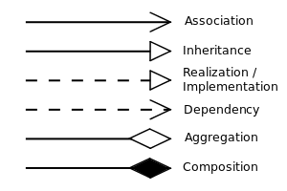
INHERITANCE
EXAMPLE
Employee in this example is a base class, while Barman, CleaningPerson and Waiter are derived classes.
Employee
Passport
NOT IS-A
IS-A
IS-A
IS-A
Barman
Waiter
Cleaning Person

Slide 12
INHERITANCE
HAS-A Relationship
Use the HAS-A test to verify whether an object should contain another object as instance variable. This is called object composition.
A Barman IS-A Passport – does not make sense
A Barman HAS-A Passport – this makes sense. So therefore, our Barman class can have an instance variable of type Passport.
internal class Barman : Employee {
private Passport _passport = new Passport();
}
IS-A relation (Inheritance)
HAS-A relation (Composition)

Slide 13
INHERITANCE
EXAMPLE
Employee in this example is a base class, while Barman, Cleaning Person and Waiter are derived classes.
Passport
Employee
Passport
HAS-A
NOT IS-A
IS-A
IS-A
IS-A
Barman
Waiter
Cleaning Person

Slide 14


INHERITANCE
EXAMPLE
Doctor
1 ... *
attends
Patient
heals
1 ... *
Person
1 ... *
Car
Person
1
Heart
1

Slide 15
INHERITANCE
BASE KEYWORD
internal class Employee {
public string Name { get; }
public double Salary { get; }
internal Employee(string name, double salary) {
Name = name;
Salary = salary;
}
}
The base keyword is used to access members of the base class from within a derived class:
Call a method on the base class that has been overridden by another method.
Specify which base-class constructor should be called when creating instances of the derived class.
internal class Barman : Employee {
public Barman(string name, double salary) : base(name, salary) { }
}
Notes:
A member's accessibility affects its visibility for derived classes as follows:
Private members are not visible in derived classes, except nested classes
Protected members are visible only in derived classes.
Internal members are visible only in derived classes that are in the same assembly as the base class.
Public inherited members can be called just as if they are defined in the derived class. Сделать схемкой

Slide 16
INHERITANCE
MEMBERS ACCESSIBILITY
While all other members of a base class are inherited by derived classes, whether they are visible or not depends on their accessibility.
internal class Employee {
public string Name { get; }
public double Salary { get; }
protected string Password { get; set; }
private long ID;
internal Employee(string name, double salary) {
Name = name;
Salary = salary;
}
}
Barman is inherited from Employee
internal class Barman : Employee {
public void Test() {
double salary = base.Salary;
string name = base.Name;
string password = base.Password;
long id = base.ID;
}
internal Barmen(string name, double salary) : base(name, salary) { }
}
internal class Program {
public void Test() {
Employee employee = new Employee("Alex", 1000);
double salary = employee.Salary;
string name = employee.Name;
string password = employee.Password;
int id = employee.ID;
}
}
Public/protected
members are visible
Private members are not visible
Not inherited from Employee
Public members
are visible
Private/protected
members are not visible
Notes:
A member's accessibility affects its visibility for derived classes as follows:
Private members are not visible in derived classes, except nested classes
Protected members are visible only in derived classes.
Internal members are visible only in derived classes that are in the same assembly as the base class.
Public inherited members can be called just as if they are defined in the derived class. Сделать схемкой

Slide 17
INHERITANCE
Implicit inheritance
All types in the .NET type system implicitly inherit from Object or a type derived from it.
The common functionality of Object is available for any type.
public class Object {
public virtual string ToString()
public virtual bool Equals(object obj)
public static bool Equals(object objA, object objB)
public static bool ReferenceEquals(object objA, object objB)
public virtual int GetHashCode()
public extern Type GetType();
protected extern object MemberwiseClone();
}
Notes:
Implicit inheritance from the Object class makes these methods available to the SimpleClass class:
The public ToString method, which converts an object to its string representation, returns the fully qualified type name
Three methods that test for equality of two objects: the public instance Equals(Object) method, the public static Equals(Object, Object) method, and the public static ReferenceEquals(Object, Object) method. By default, these methods test for reference equality; that is, to be equal, two object variables must refer to the same object.
The public GetHashCode method, which computes a value that allows an instance of the type to be used in hashed collections.
The public GetType method, which returns a Type object that represents the type.
The protected Finalize method, which is designed to release unmanaged resources before an object's memory is reclaimed by the garbage collector.
The protected MemberwiseClone method, which creates a shallow clone of the current object.

Slide 18
INHERITANCE
EQUALS AND HASHCODE
If you are implementing a value type, you should consider overriding the Equals method to gain increased performance over the default implementation of the Equals method on ValueType.
If you are implementing a reference type, you should consider overriding the Equals method if your type looks like a base type, such as Point, String, BigNumber, and so on.
Override the GetHashCode method to allow a type to work correctly in a hash table

Slide 19
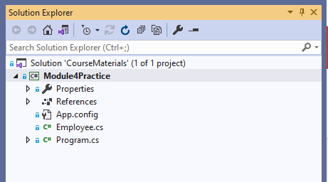
Project for hands on tasks
Preparation before the first practice
Clone the following GIT repo:
https://github.com/d-okhrimenko/CSharpForTestAutomationMaterials.git
Or make fetch/pull if you have a local copy of this repo from the previous day.
Checkout mod4_initial branch.

Slide 20

PRACTIcE 1
INHERITANCE
Clone this repo and checkout mod4_initial branch
Create classes – Barman, Waiter and CleaningPerson and inherit them from Employee class
Create method DoJob() for each employee in derived classes:
  For CleaningPerson method should print in console: $"{Name} - cleans the floor"
  For Waiter method should print in console: $"{Name} - serves the visitors."
  For Barman method should print in console: $"{Name} - makes the drinks."
Try to create the instance of each class and invoke method DoJob()

Slide 21
PRACTIcE 1
INHERITANCE
internal class CleaningPerson : Employee {
public CleaningPerson(string name, double salary) : base(name, salary) { }
public void DoJob() {
Console.WriteLine($"{this} - cleans the floor.");
}
}
internal class Waiter : Employee {
public Waiter(string name, double salary) : base(name, salary) { }
public void DoJob() {
Console.WriteLine($"{this} - serves the visitors.");
}
}
internal class Barman : Employee {
public Barman(string name, double salary) : base(name, salary) { }
public void DoJob() {
Console.WriteLine($"{this} - makes drinks.");
}
}

Slide 22
PRACTIcE 1
INHERITANCE
static void Main(string[] args) {
Barman barman = new Barman("Serhii", 1300);
Waiter waiter = new Waiter("Ivan", 1300);
CleaningPerson cleaningPerson = new CleaningPerson(“Alex", 1300);
barman.DoJob();
waiter.DoJob();
cleaningPerson.DoJob();
Console.ReadLine();
}

Slide 23

Coffee Break

Slide 24
INHERITANCE
abstract KEYWORD
The abstract keyword enables you to create classes and class members that are incomplete and must be implemented in a derived class.
An abstract class cannot be instantiated. The purpose of an abstract class is to provide a common definition of a base class that multiple derived classes can share.
internal abstract class AbstractEmployee {
//... other methods and properties
public DayOfWeek[] GetWorkSchedule() { //method is implemented in base class and available for any derived classes
return new DayOfWeek[] {
DayOfWeek.Monday,
DayOfWeek.Tuesday,
DayOfWeek.Wednesday,
DayOfWeek.Tuesday,
DayOfWeek.Friday
};
}
public abstract void DoJob(); //implementation of this method will be provided in derived classes – Barman, Waiter etc.
public override string ToString() => $"Employee: {this.Name}";
}
Notes:
Abstract classes may also define abstract methods. This is accomplished by adding the keyword abstract before the return type of the method.
Abstract methods have no implementation, so the method definition is followed by a semicolon instead of a normal method block.
Derived classes of the abstract class must implement all abstract methods.
When an abstract class inherits a virtual method from a base class, the abstract class can override the virtual method with an abstract method.

Slide 25
INHERITANCE
SEALED KEYWORD
When applied to a class, the sealed modifier prevents other classes from inheriting from it.
For example, we can put sealed modifier to Waiter, Barman and CleaningPerson classes because we do not expect that deeper inheritance.
internal sealed class Barman : AbstractEmployee {
public Barman(string name, double salary) : base(name, salary) { }
public override void DoJob() {
Console.WriteLine($"{this} - makes drinks.");
}
}

Slide 26
PRACTIcE 2
INHERITANCE
Rename class Employee to AbstractEmployee and make it abstract
  try to create instance of AbstractEmployee, is it possible? Why?
Prohibit Waiter, CleaningPerson and Barman classes from inheritance
  try to create class ExperiencedWaiter and inherit from Waiter class

Slide 27
PRACTIcE 2
INHERITANCE
internal sealed class CleaningPerson : AbstractEmployee {
public CleaningPerson(string name, double salary) : base(name, salary) { }
public void DoJob() {
Console.WriteLine($"{this} - cleans the floor.");
}
}
internal sealed class Waiter : AbstractEmployee {
public Waiter(string name, double salary) : base(name, salary) { }
public void DoJob() {
Console.WriteLine($"{this} - serves the visitors.");
}
}
internal sealed class Barman : AbstractEmployee {
public Barman(string name, double salary) : base(name, salary) { }
public void DoJob() {
Console.WriteLine($"{this} - prepares drinks.");
}
}
internal class ExperiencedWaiter : Waiter {
public ExperiencedWaiter(string name, double salary) : base(name, salary) { }
public void DoJob() {
Console.WriteLine($"{this} - serves the visitors with high quality.");
}
}

Slide 28
Coffee Break

Slide 29
INTERFACES
DEFINITION
An interface contains definitions for a group of related functionalities or “contract” that a non-abstract class must implement.
By using interfaces, you can, for example, include behavior from multiple sources in a class. That capability is important because multiple inheritance of classes is not supported in C# .
The name of an interface must be a valid C# identifier name. By convention, interface names begin with a capital “I”.
Notes:
An interface has the following properties:
An interface is typically like an abstract base class with only abstract members. Any class or struct that implements the interface must implement all its members. Optionally, an interface may define default implementations for some or all of its members. For more information, see default interface methods.
An interface can't be instantiated directly. Its members are implemented by any class or struct that implements the interface.
A class or struct can implement multiple interfaces. A class can inherit a base class and also implement one or more interfaces.

Slide 30
INTERFACES
A PROBLEM TO SOLVE
I want every employee to have – Name, Salary, BankAccount
I want every employee to have – Name, HireDate
Accountant
HR officer
I have an interface for you - IEmployeeSalary
I have an interface for you - IEmployeeHiring
Developer
Notes:
Applying abstraction means that each object should only expose a high-level mechanism for using it.
This mechanism should hide internal implementation details. It should only reveal operations relevant for the other objects.

Slide 31
INTERFACES
EXAMPLE
In this example we defined two interfaces – IEmployeeHiring and IEmployeeSalary.
IEmployeeHiring requires any class or struct that implements this interface must implement all its members - Name and HireDate.
IEmployeeSalary requires any class or struct that implements this interface must implement all its members - Name, Salary and BankAccount properties.
internal interface IEmployeeHiring {
string Name { get; }
DateTime HireDate { get; set; }
}
internal interface IEmployeeSalary {
string Name { get; }
double Salary { get; }
int BankAccount { get; set; }
}

Slide 32
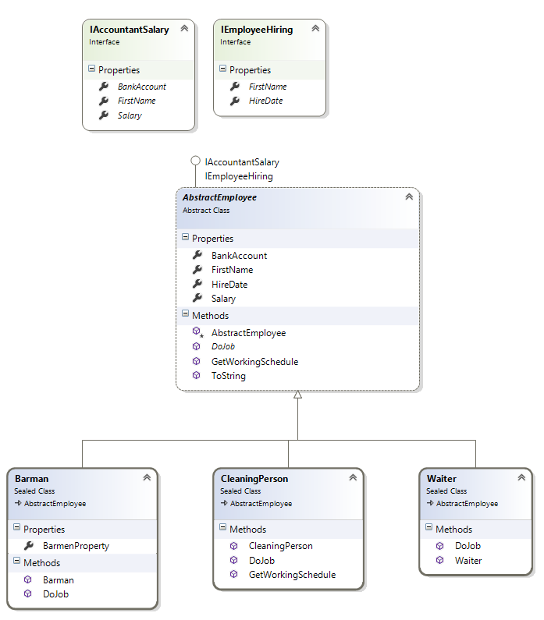
INTERFACES
EXAMPLE
AbstractEmployee in this example is a base class, which inherits from IEmployeeSalary and IEmployeeHiring.
This imposes requirements on the AbstractEmployee class – it should implement all the properties and methods from both interfaces or use abstract key word:
BankAccount, Name, Salary - IEmployeeSalary
HireDate, Name - IEmployeeHiring

Slide 33
INTERFACES
EXAMPLE
internal abstract class AbstractEmployee : IEmployeeSalary, IEmployeeHiring {
public string Name { get; }
public DateTime HireDate { get; set; }
public double Salary { get; }
public int BankAccount { get; set; }
protected Employee(string name, double salary) {
Name = name;
Salary = salary;
}
public abstract void DoJob();
public virtual DayOfWeek[] GetWorkSchedule() {
return new [] {
DayOfWeek.Monday,
DayOfWeek.Tuesday,
DayOfWeek.Wednesday,
DayOfWeek.Tuesday,
DayOfWeek.Friday
};
}
public override string ToString() => $"Employee: {this.Name}";
}

Slide 34
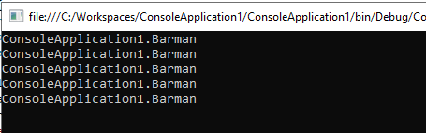
TYPE CASTING
UPCASTING
When you define a new interface, you are defining a new reference data type.
Just as classes, an interface can be used as a data type for a reference variable.
IEmployeeHiring employee1 = new Barman("Alex", 2000);
IEmployeeSalary employee2 = new Barman("Alex", 2000);
object employee3 = new Barman("Alex", 2000);
AbstractEmployee employee4 = new Barman("Alex", 2000);
Barman employee5 = new Barman("Alex", 2000);
Console.WriteLine(employee1.GetType());
Console.WriteLine(employee2.GetType());
Console.WriteLine(employee3.GetType());
Console.WriteLine(employee4.GetType());
Console.WriteLine(employee5.GetType());
Reference type variable
Data type
implicit upcasting is fully safe, since
we are casting our object "upwards" to its parent type
Notes:
So why is this called up-casting? Consider the diagram above. From Circle, we are moving up the object hierarchy to the type Shape, so we are casting our object "upwards" to its parent type.
Up-casting is implicit and is safe. What do we mean by safe? Well, we can happily cast Circle to Shape and expect all the properties and methods of Shape to be available.

Slide 35
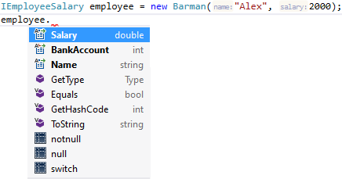
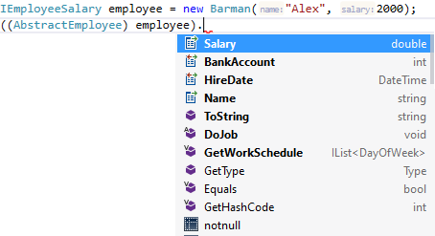
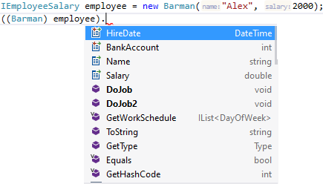
TYPE CASTING
DOWNCASTING
Abstraction allows making relevant information visible and encapsulation enables a programmer to implement the desired level of abstraction.
Downcasting merely refers to the process of casting an object of a base class type to a derived class type.
In this example, on each downcasting step we achieve different level of class method/properties visibility, it increases on each step, unless upcasting, where visibility decreases on each upcasting.
explicit downcast
explicit downcast
Notes:
So why is this called up-casting? Consider the diagram above. From Circle, we are moving up the object hierarchy to the type Shape, so we are casting our object "upwards" to its parent type.
Up-casting is implicit and is safe. What do we mean by safe? Well, we can happily cast Circle to Shape and expect all the properties and methods of Shape to be available.

Slide 36
PRACTIcE 3
CASTING
Create the local variables in Main method. Is it downcast or uppercast?
Comment out all code that leads to compile errors. You will fix this in the next practice
Modify the Barman class with new method – DoJob2()
  New method should print in the Console - $"{Name} - cleaning the workplace."
Check the available methods on variable – barman: is method DoJob2() visible, how you can invoke it?
Try to cast waiter variable to Barman class, is it possible? Try to run the program.
AbstractEmployee barman = new Barman("Serhii", 1500);
AbstractEmployee waiter = new Waiter("Alex", 1600);

Slide 37
PRACTIcE 3
CASTING
internal class Program {
static void Main(string[] args) {
AbstractEmployee barman = new Barman("Serhii", 1500);
AbstractEmployee waiter = new Waiter("Alex", 1600);
((Barman) barman).DoJob2();
Barman barman2 = (Barman) waiter;
Console.ReadLine();
}
}
internal sealed class Barman : AbstractEmployee {
public Barman(string name, double salary) : base(name, salary) { }
public void DoJob2() {
Console.WriteLine($"{this} - cleaning the workplace.");
}
public void DoJob() {
Console.WriteLine($"{this} - makes drinks.");
}
}

Slide 38

LUNCH

Slide 39
Polymorphism
DEFINITION
Polymorphism is often referred to as the third pillar of object-oriented programming, after encapsulation and inheritance.
Polymorphism is a Greek word that means "many-shaped“.
AbstractEmployee employee1 = new Barman("Alex", 1000);
AbstractEmployee employee2 = new Waiter("Serhii", 1000);
employee1.DoJob();
employee2.DoJob();
Prints: “Alex – makes drinks.”
Prints: “Serhii – serves the visitors.”
Notes:
The term "Polymorphism" is the combination of "poly" + "morphs" which means many forms. It is a greek word. In object-oriented programming, we use 3 main concepts: inheritance, encapsulation and polymorphism.
And it has two distinct aspects
Objects of a derived class may be treated as objects of a base class such as method parameters and collections or arrays.
Base classes may define and implement virtual methods, and derived classes can override them, which means they provide their own definition and implementation.

Slide 40
Polymorphism
TYPES OF Polymorphism
There are two types of polymorphism in C# - compile time polymorphism and runtime polymorphism.
Polymorphism
Static
Dynamic
Method overloading
Operator overloading
Method overriding
Notes:
Compile time polymorphism is achieved by method overloading and operator overloading in C#. It is also known as static binding or early binding.
Runtime polymorphism in achieved by method overriding which is also known as dynamic binding or late binding.

Slide 41
Polymorphism
VIRTUAL KEYWORD
The virtual keyword is used to modify a method, property, indexer, or event declaration and allow its override in a derived class.
For example, this method can be overridden by any class that inherits it:
Base class:
internal abstract class AbstractEmployee {
//... other methods and properties
public virtual DayOfWeek[] GetWorkSchedule() {
return new [] {
DayOfWeek.Monday,
DayOfWeek.Tuesday,
DayOfWeek.Wednesday,
DayOfWeek.Tuesday,
DayOfWeek.Friday
};
}
}
Derived class:
internal sealed class CleaningPerson : AbstractEmployee {
//... other methods and properties
public override DayOfWeek[] GetWorkSchedule() {
return new [] {
DayOfWeek.Tuesday, DayOfWeek.Wednesday, DayOfWeek.Friday
};
}
}
A virtual keyword allows to override method DoJob
implemented in base class - AbstractEmployee
Notes:
By default, methods are non-virtual. You cannot override a non-virtual method.
You cannot use the virtual modifier with the static, abstract, private, or override modifiers.

Slide 42
Polymorphism
OVERRIDE KEYWORD
The override modifier is required to extend or modify the abstract or virtual implementation of an inherited method, property, indexer, or event.
Base class:
internal abstract class AbstractEmployee {
//... other methods and properties
public abstract void DoJob()
}
Derived class:
internal sealed class CleaningPerson : AbstractEmployee {
//... other methods and properties
public override void DoJob() {
Console.WriteLine($"{this} - cleans the floor.");
}
}
An abstract method DoJob in base class - AbstractEmployee
is implemented in a derived class - CleaningPerson
Notes:
An override method provides a new implementation of a member that is inherited from a base class. The method that is overridden by an override declaration is known as the overridden base method. The overridden base method must have the same signature as the override method. For information about inheritance, see Inheritance.
You cannot override a non-virtual or static method. The overridden base method must be virtual, abstract, or override.
An override declaration cannot change the accessibility of the virtual method. Both the override method and the virtual method must have the same access level modifier.
You cannot use the new, static, or virtual modifiers to modify an override method.
An overriding property declaration must specify exactly the same access modifier, type, and name as the inherited property, and the overridden property must be virtual, abstract, or override.

Slide 43
Polymorphism
OVERRIDE KEYWORD, EXAMPLE
Polymorphism over method overriding:
AbstractEmployee employee1 = new Barman("Alex", 1000);
AbstractEmployee employee2 = new Waiter("Serhii", 1000);
employee1.DoJob();
employee2.DoJob();
internal sealed class Barman : AbstractEmployee {
public Barman(string name, double salary) : base(name, salary) { }
public override void DoJob() {
Console.WriteLine($"{this} - prepares drinks.");
}
}
internal sealed class Waiter : AbstractEmployee {
public Waiter(string name, double salary) : base(name, salary) { }
public override void DoJob() {
Console.WriteLine($"{this} - serves the visitors.");
}
}
Prints: “Alex – makes drinks.”
Prints: “Serhii – serves the visitors.”
Notes:
An override method provides a new implementation of a member that is inherited from a base class. The method that is overridden by an override declaration is known as the overridden base method. The overridden base method must have the same signature as the override method. For information about inheritance, see Inheritance.
You cannot override a non-virtual or static method. The overridden base method must be virtual, abstract, or override.
An override declaration cannot change the accessibility of the virtual method. Both the override method and the virtual method must have the same access level modifier.
You cannot use the new, static, or virtual modifiers to modify an override method.
An overriding property declaration must specify exactly the same access modifier, type, and name as the inherited property, and the overridden property must be virtual, abstract, or override.

Slide 44
Polymorphism
NEW KEYWORD
When used as a declaration modifier, the new keyword explicitly hides a member that is inherited from a base class.
When you hide an inherited member, the derived version of the member replaces the base class version.
internal sealed class Barman : AbstractEmployee {
//... other methods and properties
public new void Describe() {
Console.WriteLine("Shadowed description.");
}
}
Notes:
Although you can hide members without using the new modifier, you get a compiler warning.

Slide 45
Polymorphism
NEW KEYWORD, EXAMPLE
AbstractEmployee barman = new Barman("Alex", 1000);
AbstractEmployee waiter = new Waiter("Serhii", 1000);
barman.Describe();
waiter.Describe();
((Barman)barman).Describe();
((Waiter)waiter).Describe();
internal abstract class AbstractEmployee {
//... other methods and properties
public virtual void Describe() {
Console.WriteLine("Default description.");
}
}
internal sealed class Barman : AbstractEmployee {
//... other methods and properties
public new void Describe() {
Console.WriteLine("Shadowed description.");
}
}
internal class Waiter : AbstractEmployee {
//... other methods and properties
public override void Describe() {
Console.WriteLine("Overridden description.");
}
}
Prints: “Default description.”
Prints: “Overridden description.”
Prints: “Shadowed description.”
Prints: “Overridden description.”

Slide 46
Polymorphism
OVERLOADING
Method Overloading is the common way of implementing polymorphism.
int CalculateSum(int x, int y)
{
return x + y;
}
int CalculateSum(int x, int y, int z)
{
return x + y + z;
}
double CalculateSum(double x, double y)
{
return x + y;
}
int CalculateSum(double x, double y)
{
return (int)(x + y);
}
Shared name but different method signature.
Method signature does not include the return type of the method. A class cannot have two methods with same signature.
compile error - method cannot be overloaded over different return type
Notes:
A method signature is a unique identification of a method for the C# compiler.
The signature consists of a method name and the type and kind (value, reference, or output) of each of its formal parameters.
Method signature does not include the return type.
User can implement overloading by defining two or more methods in a class sharing the same name.
Overloaded methods are differentiated based on the number and type of the parameters, passed as arguments to the methods.
You cannot define more than one method with the same name and the type of the arguments. It will result in compiler error.
You cannot declare two methods with the same signature and different return type.

Slide 47
Polymorphism
OVERLOADING, EXAMPLE
No method overloading, each employee type requires to call different method to accrued the salary.
internal class Accountant {
public void AccruedWaiterSalary(Waiter employee) {
Console.WriteLine($"Salary transferred for employee: {employee.Name} on bank account: {employee.BankAccount}, amount {employee.Salary}.");
}
public void AccruedBarmanSalary(Barman employee) {
Console.WriteLine($"Salary transferred for employee: {employee.Name} on bank account: {employee.BankAccount}, amount {employee.Salary}.");
}
public void AccruedCleaningPersonSalary(CleaningPerson employee) {
Console.WriteLine($"Salary transferred for employee: {employee.Name} on bank account: {employee.BankAccount}, amount {employee.Salary}.");
}
}

Slide 48
Polymorphism
OVERLOADING, EXAMPLE
Method overloading – the shared name but can handle 3 different Objects
internal class Accountant {
public void AccruedSalary(Waiter employee) {
Console.WriteLine($"Salary transferred for employee: {employee.Name} on bank account: {employee.BankAccount}, amount {employee.Salary}.");
}
public void AccruedSalary(Barman employee) {
Console.WriteLine($"Salary transferred for employee: {employee.Name} on bank account: {employee.BankAccount}, amount {employee.Salary}.");
}
public void AccruedSalary(CleaningPerson employee) {
Console.WriteLine($"Salary transferred for employee: {employee.Name} on bank account: {employee.BankAccount}, amount {employee.Salary}.");
}
}
Use abstraction type - now one method can handle all employee types.
internal class Accountant {
public void AccruedSalary(IEmployeeSalary employee) {
Console.WriteLine($"Salary transferred for employee: {employee.Name} on bank account: {employee.BankAccount}, amount {employee.Salary}.");
}
}

Slide 49
Polymorphism
OPERAtOR OVERLOADING
A user-defined type can overload a predefined C# operator. That is, a type can provide the custom implementation of an operation in case one or both operands are of that type.
public static double operator +(Employee employee1, Employee employee2) {
return employee1.Salary + employee2.Salary;
}
var barmen = new Barmen() {
Salary = 1000
};
var cleaningPerson = new CleaningPerson() {
Salary = 2000
};
double totalSalary = barmen + cleaningPerson;

Slide 50
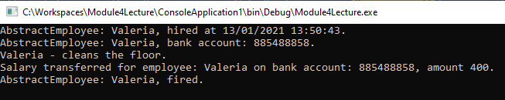
Polymorphism
Polymorphism, EXAMPLE
var humanResources = new HumanResources();
var accountant = new Accountant();
var manager = new Manager();
AbstractEmployee employee = humanResources.FindApplicant();
manager.HireEmployee(employee);
accountant.HireEmployee(employee);
employee.DoJob();
accountant.AccruedSalary(employee);
manager.FireEmployee(employee);
Console.ReadLine();
if (employee is Waiter) {
manager.HireWaiter(employee);
accountant.HireWaiter(employee);
employee.DoJob();
accountant.AccruedWaiterSalary(employee);
manager.FireWaiter(employee);
} else if (employee is Barman) {
manager.HireBarman(employee);
accountant.HireBarman(employee);
employee.DoJob();
accountant.AccruedBarmanSalary(employee);
manager.FireBarman(employee);
} else if (employee is CleaningPerson) {
manager.HireCleaningPerson(employee);
accountant.HireCleaningPerson(employee);
employee.DoJob();
accountant.AccruedCleaningPersonSalary(employee);
manager.FireCleaningPerson(employee);
}
Console.WriteLine();
The same code, but without using
polymorphism over overloading

Slide 51
PRACTIcE 4
Polymorphism
Provide method GetWorkSchedule() in AbstractEmployee class and make it virtual, the default implementation should return only weekdays.
Use system type – DayOfWeek
Override GetWorkSchedule() from AbstractEmployee class
  working days for CleaningPerson: Tuesday, Wednesday, Friday
  working days for Waiter: Monday, Wednesday, Saturday
Create abstract method DoJob in AbstractEmployee class and provide necessary corrections in the derived classes
Try to create the instance of each derived classes and invoke methods: DoJob and GetWorkSchedule in Console application, use AbstractEmployee type to store each instance.
  what output did you get for Waiter, CleaningPerson and Barman? Why?
  To allow output of the working days to console use this syntax:
  Console.WriteLine("Working days: " + string.Join(", ", employee.GetWorkSchedule()));

Slide 52
PRACTIcE 4
Polymorphism
internal abstract class AbstractEmployee {
public string Name { get; }
public double Salary { get; }
protected AbstractEmployee(string name, double salary) {
Name = name;
Salary = salary;
}
public abstract void DoJob();
public virtual DayOfWeek[] GetWorkSchedule() {
return new [] {
DayOfWeek.Monday,
DayOfWeek.Tuesday,
DayOfWeek.Wednesday,
DayOfWeek.Tuesday,
DayOfWeek.Friday
};
}
public override string ToString() => Name;
}

Slide 53
PRACTIcE 4
Polymorphism
internal sealed class CleaningPerson : AbstractEmployee {
public CleaningPerson(string name, double salary) : base(name, salary) { }
public override DayOfWeek[] GetWorkSchedule() {
return new [] {
DayOfWeek.Tuesday, DayOfWeek.Wednesday, DayOfWeek.Friday
};
}
public override void DoJob() {
Console.WriteLine($"{this} - cleans the floor.");
}
}
internal sealed class Waiter : AbstractEmployee {
public Waiter(string name, double salary) : base(name, salary) { }
public override DayOfWeek[] GetWorkSchedule() {
return new [] {
DayOfWeek.Monday, DayOfWeek.Wednesday, DayOfWeek.Saturday
};
}
public override void DoJob() {
Console.WriteLine($"{this} - serves the visitors.");
}
}
internal sealed class Barman : AbstractEmployee {
public Barman(string name, double salary) : base(name, salary) { }
public override void DoJob() {
Console.WriteLine($"{this} - prepares drinks.");
}
}

Slide 54
PRACTIcE 4
Polymorphism
static void Main(string[] args) {
AbstractEmployee barman = new Barman("Serhii", 1300);
AbstractEmployee waiter = new Waiter("Ivan", 1300);
AbstractEmployee CleaningPerson = new CleaningPerson("Alex", 1300);
barman.DoJob();
Console.WriteLine("Working days: " + string.Join(", ", barman.GetWorkSchedule())));
waiter.DoJob();
Console.WriteLine("Working days: " + string.Join(", ", waiter.GetWorkSchedule())));
CleaningPerson.DoJob();
Console.WriteLine("Working days: " + string.Join(", ", CleaningPerson.GetWorkSchedule())));
Console.ReadLine();
}

Slide 55
Homework

